Slide 1
Reconciliation Worksheet
Reconciling Net Income and Cash Flow from Operations Using the Worksheet in the YALEiE Reconciliation_Tool

Slide 2
Cash Flow Statement Overview
Cash flow statements explain the change in cash:
For Ralphy’s Business:
Cash @ Beginning
Cash @ End
Why?
$0
$40.05
Why the increase of $40.05?

Slide 3
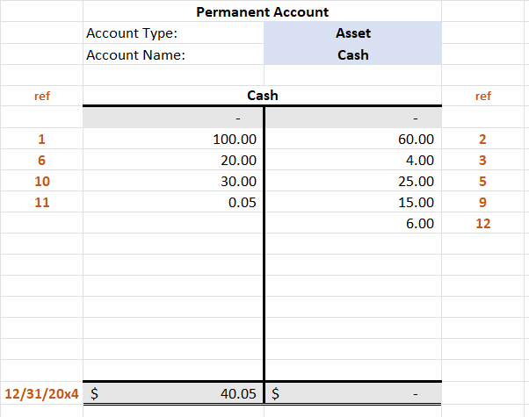
The Cash T-account Has All the Amounts of Increases (Debits) and Decreases (Credits)
Increases
Decreases

Slide 4
We Are Not Going to Report Every Debit and Credit to Cash
Think about it – McDonald’s trying to report every cash sale, etc.
We are going to group the changes into three categories:
Operating
Investing
Financing
Learning-Accounting site has a brief discussion of these categories.

Slide 5
Cash T-Account Statement of Problem
We need sort these
into whether they arose
from operating, investing
or financing activities.
That’s what the Cash Flow
Column (I) in the Journal is for.

Slide 6
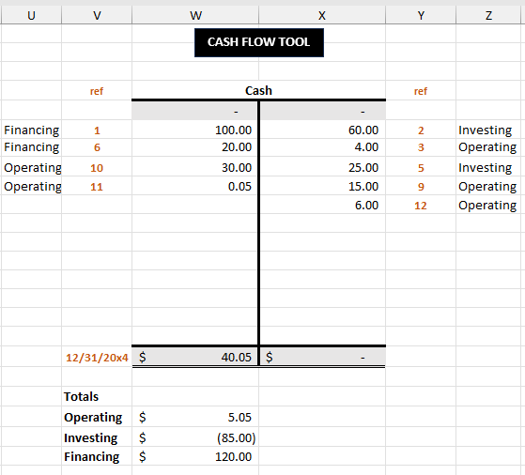
New Tool: Cash Flow Tool on Tools Tab
Cash T-account
Labels taken from Journal
Labels used to calculate totals

Slide 7
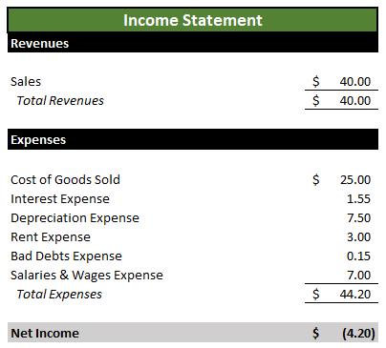
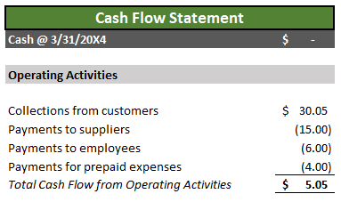
Last Thing: Reconcile Cash Flow from Operations and Net Income
Why are these numbers different?

Slide 8
Details
Not in CFS at all!
Collections from customers ≠ Sales
Payments for prepaid rent ≠ Rent Expense
Payments to employees ≠ Salaries & Wages Expense
Payments to suppliers ≠ Cost of Goods Sold

Slide 9
We need some algebra …
Beginning and Ending Balance sheets both balance.
So the change in Cash is equal to the change in all the other accounts:
Suppose we have Cash, one asset other than cash, one liability.
Subtracting the Ending Balance sheet from the Beginning:
Beginning Balance Sheet: Cash_{B} + NoncashAsset_{B} = Liability_{B} + Common Stock_{B} + Retained Earnings_{B}
Ending Balance Sheet: Cash_{E} + NoncashAsset_{E} = Liability_{E} + Common Stock_{E} + Retained Earnings_{E}

Slide 10
Algebra …
Subtract the Beginning Balance sheet from the Ending Balance sheet and suppose no Common Stock was issued or repurchased:
Cash_{E} + NoncashAsset_{E} - Liability_{E} - Common Stock_{E} - Retained Earnings_{E}
-
(Cash_{B} + NoncashAsset_{B} - Liability_{B} - Common Stock_{B} - Retained Earnings_{B})
(Cash_{E} – Cash_{B}) + (NoncashAsset_{E} – Noncash Asset_{B})
– (Liability_{E} – Liability_{B}) – (Retained Earnings_{E} – Retained Earnings_{B}) = 0

Slide 11
More Algebra …
(Cash_{E} – Cash_{B}) = – (NoncashAsset_{E} – Noncash Asset_{B})
+ (Liability_{E} – Liability_{B})
+ (Retained Earnings_{E} – Retained Earnings_{B})
= Cash Flow from Operations
+ Cash Flow from Investing
+ Cash Flow from Financing

Slide 12
Problem Boils Down to …
Figuring out which parts of each of these changes
are due to Operations
( NoncashAsset_{E} – Noncash Asset_{B})
(Liability_{E} – Liability_{B})
(Retained Earnings_{E} – Retained Earnings_{B})

Slide 13
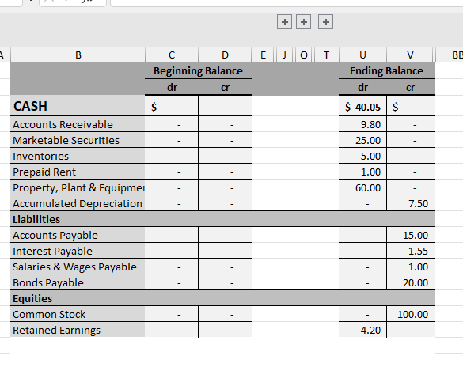
From the Reconciliation Tool in the YALEiE

Slide 14
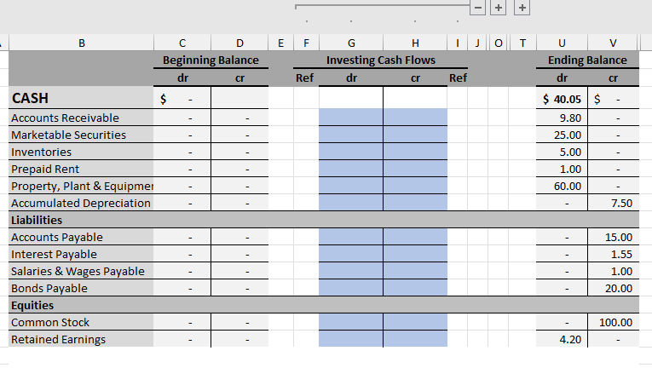
From the Reconciliation Tool in the YALEiE

Slide 15
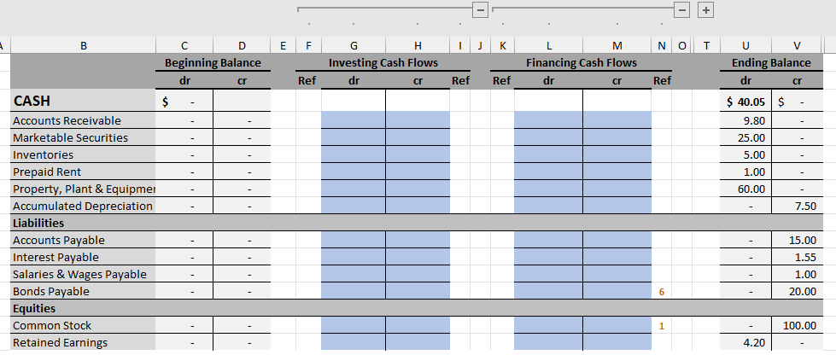
From the Reconciliation Tool in the YALEiE

Slide 16
Let’s go to the YALEiE!!

